Slide 1


April 2023
Notes:
PO: Q: How many of you use a filter at home for drinking water?
RB: We don't trust the tap water. We know that there are contaminants like lead.
SK: But how harmful is lead. Do you guys know?!
MK: Lead causes brain damage. It's true look it up.
WL: Stats: The permissible limit of lead is 15 ppb <explain ppb> And the water found in some parts of California is 4,700 ppb! Isn't that crazy??
PO: How do we solve this problem?
RB: AQUACHAIN!!! We ensure clean drinking water through the use of blockchain technology.
MK: Let me explain how???

Slide 2
Problem
Contaminated Water
Contamination: aging infrastructure, human activities such as illegal dumping and sewage spills
In 2021, reported violations involving water treatment rules were responsible for exceeding health-based standards for 15.6 million people
Brain damage and developmental issues in children, such as IQ loss, learning disabilities, hyperactivity, inability to concentrate, and behavioral problems.
4,700 parts per billion (ppb) - well above the EPA's action level of 15 ppb.
Slide by William

Slide 3
Solution
Transparency
Real-time Monitoring
Efficient Resource Allocation
- Blockchain technology enables transparent and immutable recording of water quality.
- Every water transaction is securely recorded on the Blockchain, providing a complete audit trail.
- IoT sensors integrated with the Blockchain enable real-time monitoring of water quality, pressure, and usage levels across the distribution network.
- Utilities can proactively identify leaks, detect anomalies, and respond to emergencies faster.
- Smart contracts deployed on the Blockchain automate water allocation, optimizing resource utilization based on real-time demand and supply data.
- Utilities and municipalities can dynamically adjust water distribution schedules and prioritize critical areas.
Slide by Mihir

Slide 4
Our Vision
“AquaChain envisions a world where every individual has access to clean and safe water, contributing to global sustainability.”
Slide by Mihir

Slide 5
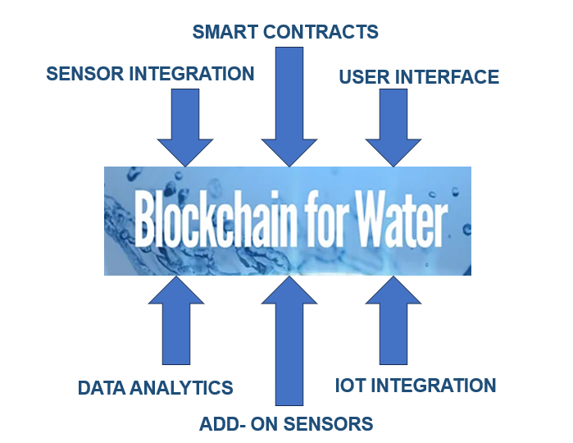
Features & Functions
AquaChain sets itself apart from existing water management systems by combining decentralized blockchain technology, intelligent smart contracts, and seamless sensor integration to provide unmatched transparency, efficiency, and dependability in water supply management and sanitation.
FEATURES
01
Record Keeping
Transparency
Automation
Real-time Monitoring
Decision Support
Compliance Assurance
Sustainability Promotion
Decentralized Blockchain Network
Sensor Integration
Smart Contracts
User Interface
Data Analytics Module
IoT Integration
Option for Sensor Add-On
02
FUNCTIONS
USP
03
Slide by Shruti

Slide 6
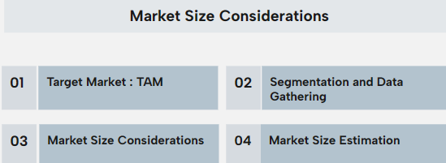
Market
TAM
Total Addressable Market (TAM)
Targets United States & Globally
Utility companies
Municipalities
Water management organizations
Regulatory agencies
$275.2 million
Serviceable Addressable Market (SAM)
Targets other region/states in United States apart from Southern California.
SAM
$55.04 million
SOM
Serviceable Obtainable Market (SOM)
Targets Southern California in United States.
$8.26 million
Slide by Rachana

Slide 7
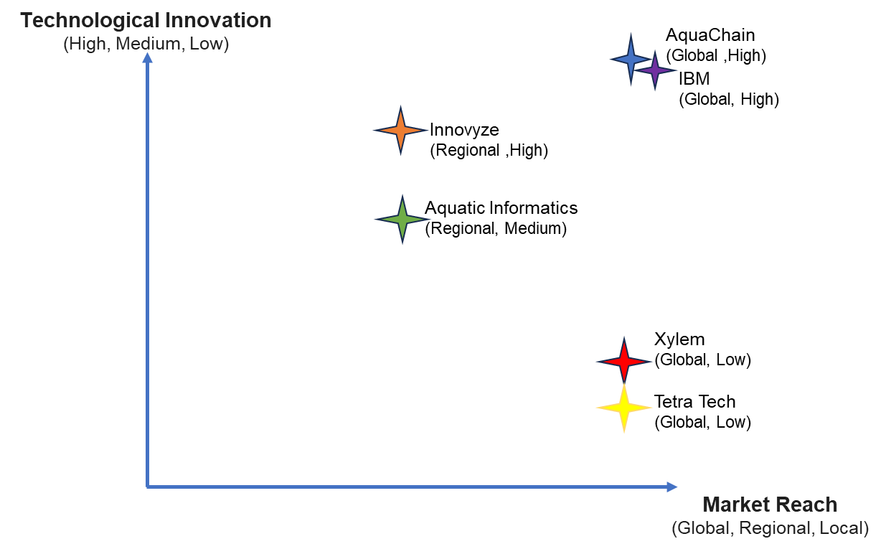
Competition and Risk
Competitive Strategies
Advertising Blockchain-Powered Security
Customizable Solutions for Real-World Impact
Fostering a Collaborative Ecosystem
Sustainability Leadership
Continuous Innovation
Top 10 Customers
Top 5 Competitors
Metropolitan Water District of Southern California
Los Angeles Department of Water and Power (LADWP)
City of Los Angeles: Municipality
City of San Diego: Municipality
City of Long Beach: Municipality
San Diego Water Authority
Long Beach Water Department
California State Water Resources Control Board
Orange County Water District
Irvine Ranch Water District
1. Technological Advancements by Competitors
2. Regulatory Changes
3. Cybersecurity Threats
4. Market Volatility
5. Intense Competition from Established Players
Risks Overview
Slide by Rachana
Notes:
Detailed Risk Analysis is in the attached sheet Aquachain's Risk Management - Google Sheets
Detailed Competitive Strategies and competitive benefits in the sheet Aquachain's Competitive Strategies - Google Docs

Slide 8
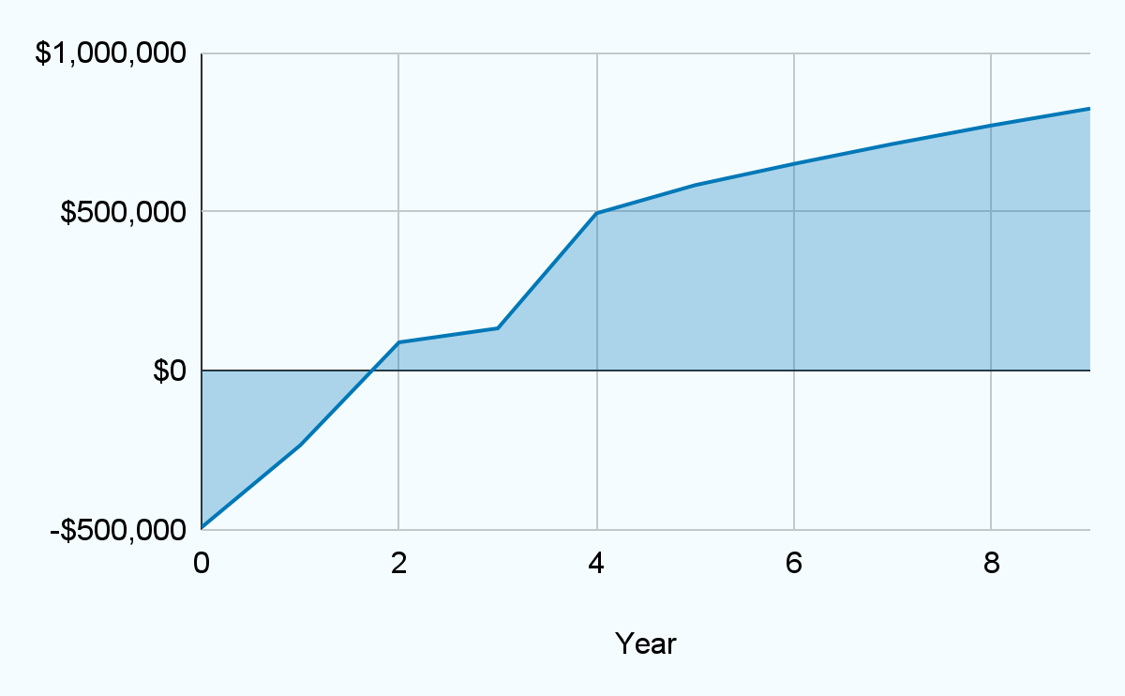
Predicted growth
From 2024-2034
We expect the revenue to grow at IRR 36% with gross revenue about $11M at the EOL.
Our margin is 31%.
Projected Cash Flow: Graph linked to cash flow projections.
174.48$
$3,500,000
Selling Price per unit
Expected income
Slide by Mihir

Slide 9
Our traction
$19 billion
1 trillion
Invested in blockchain solutions
Gallons wasted annually by US households
$3.1 trillion
66%
Market compound annual
growth rate
Added business value by 2030
Slide by William
Notes:
https://connect.comptia.org/blog/blockchain-statistics
https://gitnux.org/water-waste-statistics/#:~:text=Highlights%3A%20Water%20Waste%20Statistics,home%20is%20around%2058%20gallons.
Blockchain technology is a driver of innovation. The blockchain market possesses a market compound growth rate of 66%. And billions of dollars have been invested to develop blockchain solutions to some of the worlds most complex problems. It is estimated that blockchain will add over 3 trillion dollars in business value by 2030. Aquachain will not only own the smart water management sector of the blockchain market but will also contrubite to water waste reduction and clean water for everyone.

Slide 10
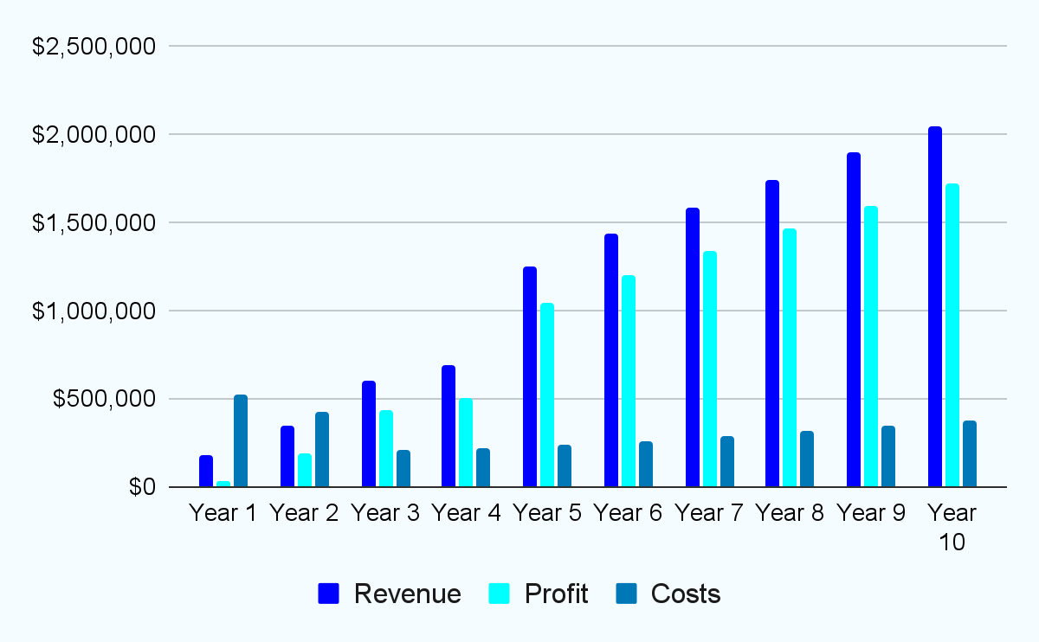
$11M Revenue Projected in 10 Years
10 Year Financial Forecast:
AquaChain’s 10 Year Success:
83%
122%
gross profit margin
ROI
13%
$6M
CAGR for water management systems market
EBITDA
Slide by Patrick
Notes:
CAGR - compounded annual growth rate

Slide 11
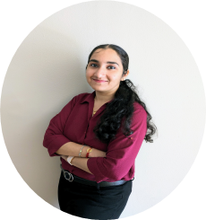
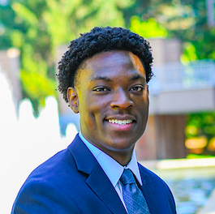
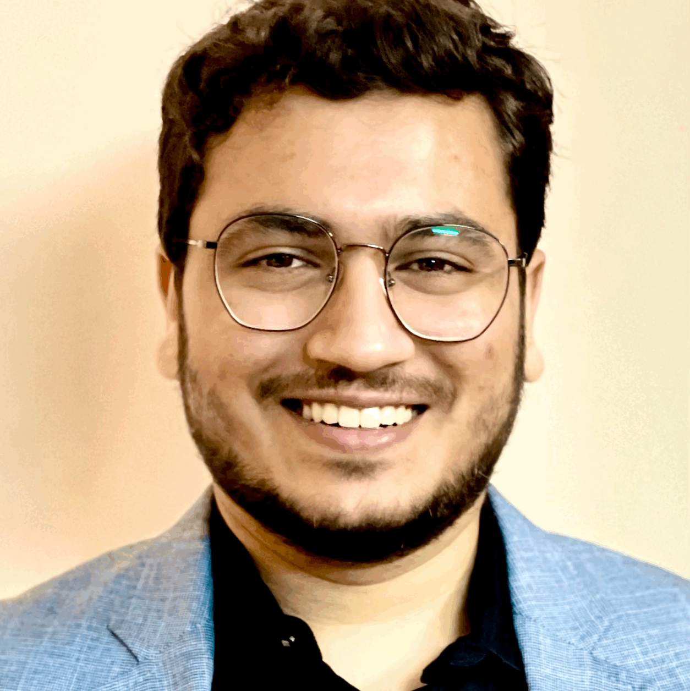


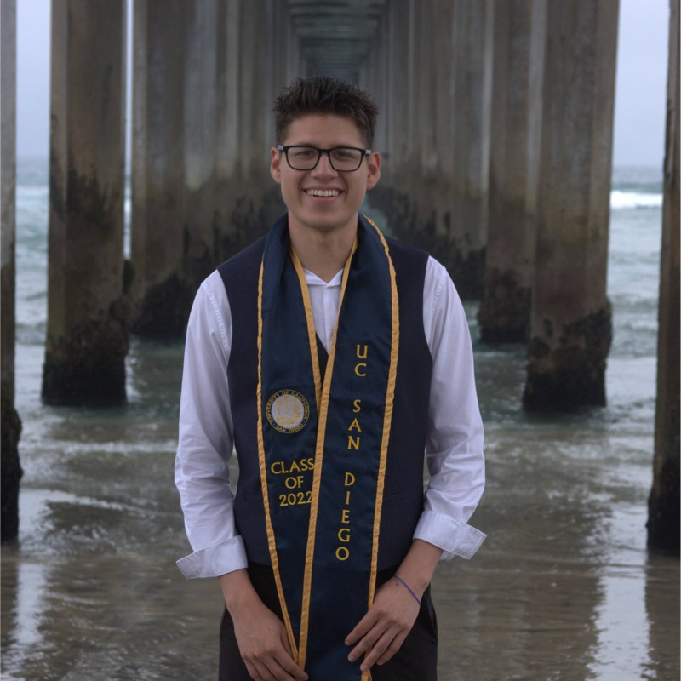
The AquaLinks
Patrick Okimi
CEO
Mihir Kavishwar
CFO
Shruti Kalyanaraman
CPO
Rachana
CMO
William Lopez
COO
-Hardware Product developer
- Mechanical Engineer at Heart
- Consumer Goods Background
- IoT and electronics engineer.
- Software Engineering at MathWorks
- Expert in Financial modelling
- Product Management
- Decision Making
- Market & Customer Insights
-Technical Expertise
-Marketing Savvy
-Energy Industry Experience
- Operations Leader in Aerospace Industry
- Mechanical Engineering Background
Notes:
Consumer Goods Industry
Software Engineer at MathWorks
Continuous Business Operations - Education Management Industry
Royal Dutch Shell
Lockheed Martin,
Raytheon Technologies
Patrick Okimi CEO
Mihir Kavishwar CFO
Shruti Kalyanaraman CPO
Rachana Bangalore Nagaraju CMO
William Lopez COO

Slide 12
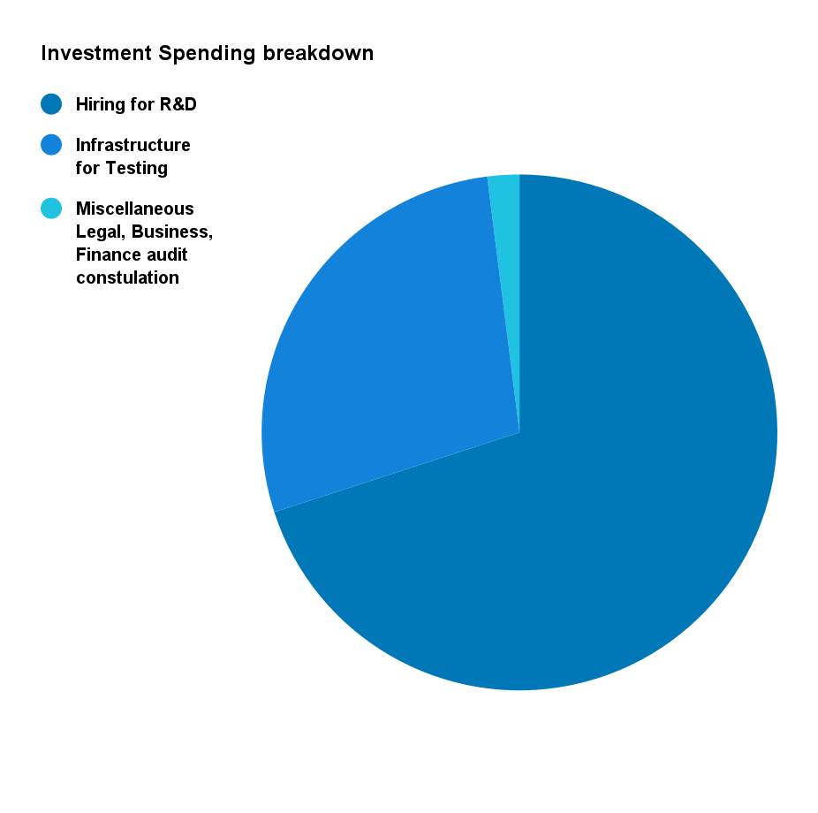
The Ask: 3M for 5%
70%
122%
Hiring
ROI
Hiring talent for outreach and marketing.
Incentives for investors.
28%
2%
Infrastructure
Other
Systems, office space and testing equipment.
Legal and consultation fees, accounting.
Slide by Mihir

Slide 13
Thanks!
Do you have any questions?
Details: Team1: Overview of Commercialization

